Slide 1


Crime Analysts Datasets -Crimes: last year to present -Chicago Map -Population 2022
Jibreel Mohamed
Sajal Chandra

Slide 2
Hypothesis
Before beginning our analysis, we came up with the following hypotheses:
Crimes related to Theft are the highest type of crime
Crimes related to drug consumption take place in secluded regions away from downtown

Slide 3

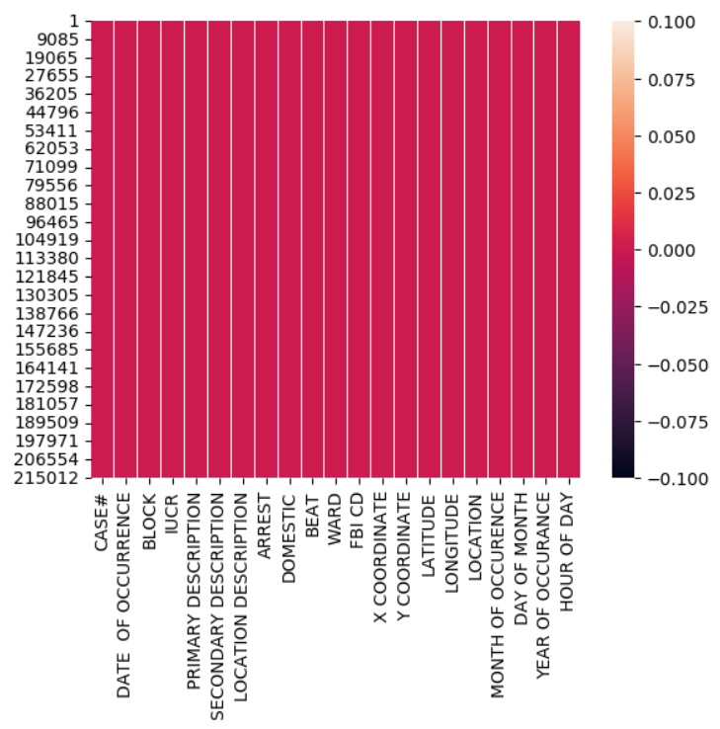

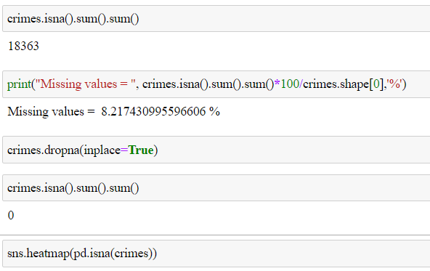
Checking and clearing NAN values

Slide 4
What we have in the main dataset
CASE#
DATE OF OCCURRENCE
BLOCK
IUCR
PRIMARY DESCRIPTION
SECONDARY DESCRIPTION
ARREST
DOMESTIC
BEAT
WARD
FBI CD
X COORDINATE
Y COORDINATE
LATITUDE
LONGITUDE
LOCATION

Slide 5
What we have in the main dataset
CASE#
DATE OF OCCURRENCE
BLOCK
IUCR
PRIMARY DESCRIPTION
SECONDARY DESCRIPTION
ARREST
DOMESTIC
BEAT
WARD
FBI CD
X COORDINATE
Y COORDINATE
LATITUDE
LONGITUDE
LOCATION
YEAR
MONTH
DAY
HOUR
DESCRIPTION

Slide 6
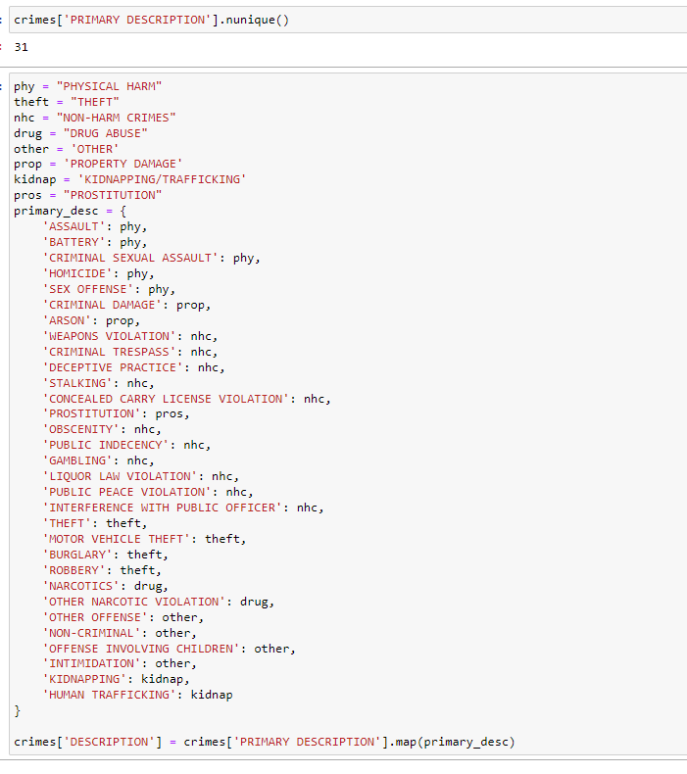
Make broad categories for easier understanding

Slide 7
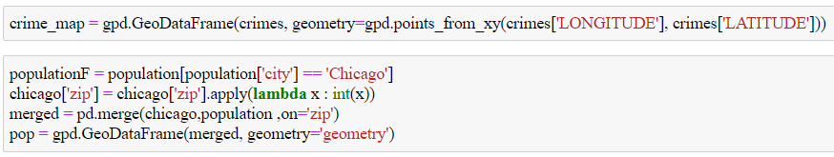
Merging the population with the map

Slide 8

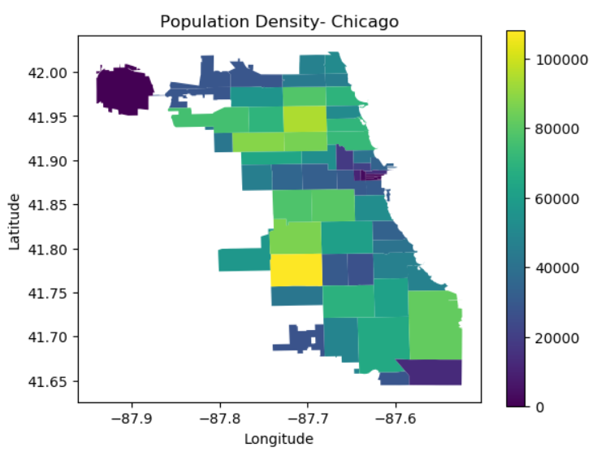
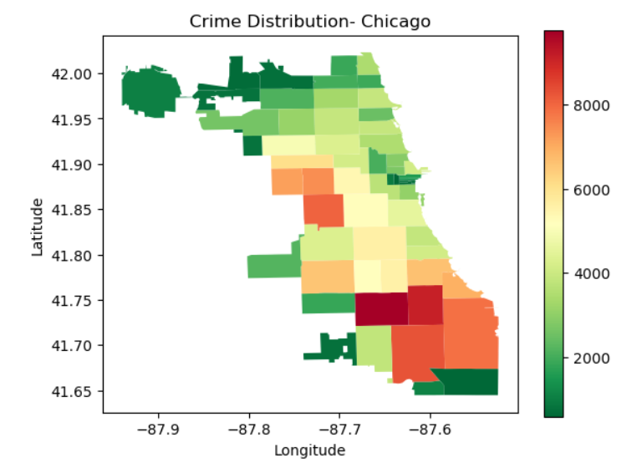
Comparing the population with crimes in Chicago

Slide 9
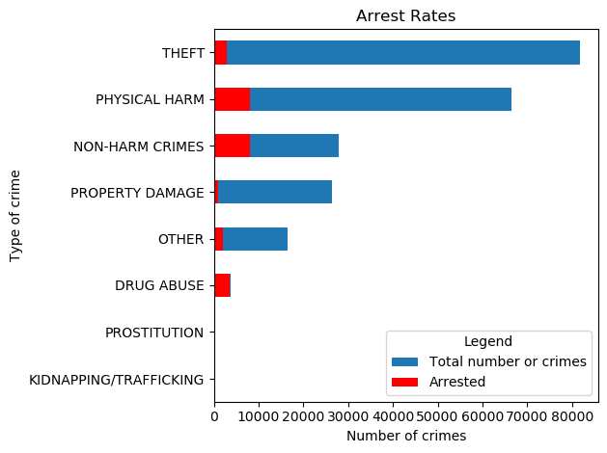
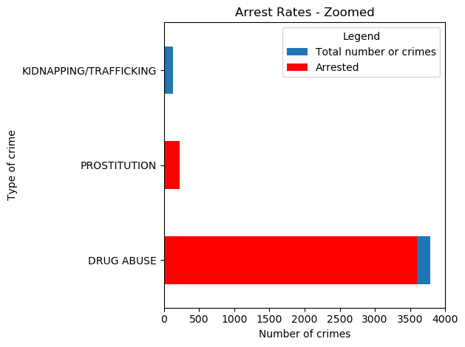
Arrest rates of different crimes
Theft has an arrest rate of only 3.5%
Drug abuse has an arrest rate of over 95%
Prostitution has an arrest rate of over 98%
Kidnapping/Trafficking has an arrest rate of less than 8%.

Slide 10
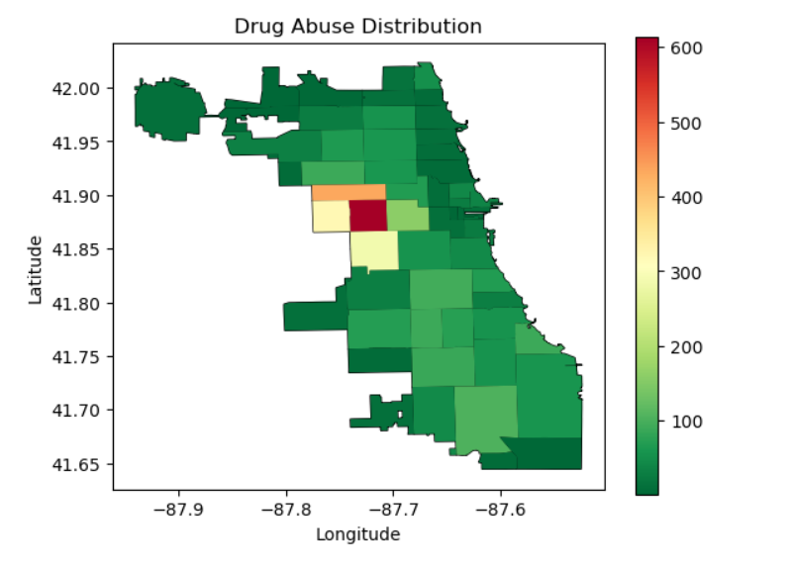
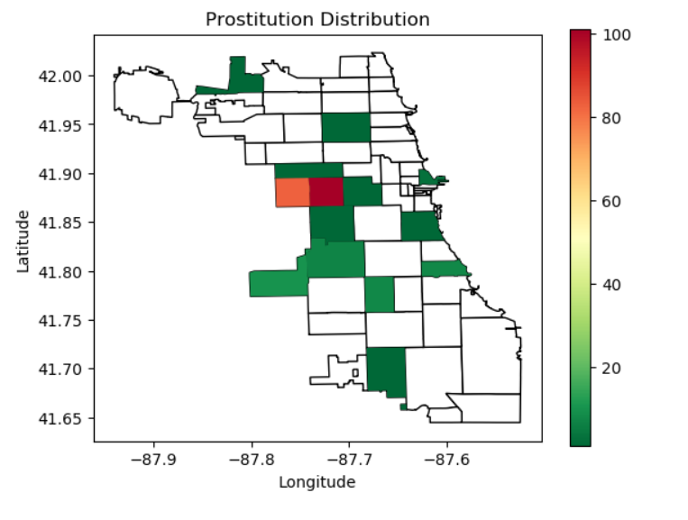
Comparing the distribution of Prostitution and Drug Abuse cases

Slide 11
Hypothesis
The areas with high Prostitution and Drug Abuse should have higher arrest rates for other types of crimes compared to the neighboring areas.

Slide 12
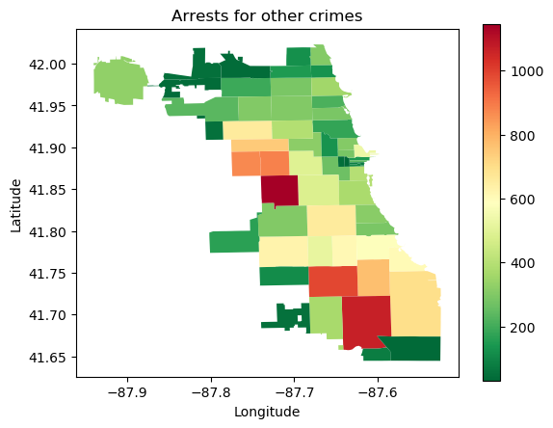
Arrests for crimes other than Drug Abuse and Prostitution
Areas with high Drug Abuse and Prostitution have significantly higher arrest rates for other crimes too
Our Hypothesis is CORRECT!

Slide 13
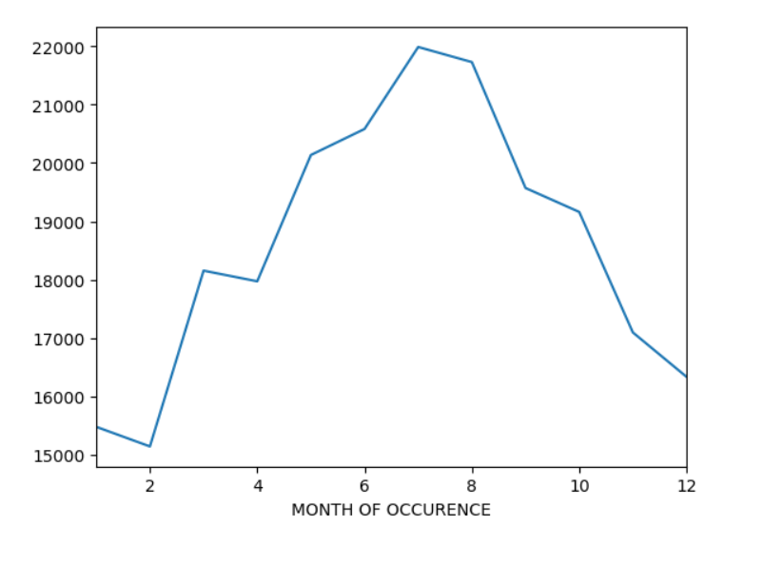
Crime Rates by Months

Slide 14
Revisiting our Initial Hypotheses
Crimes related to Theft are the highest type of crime: TRUE!
Crimes related to drug consumption take place in secluded regions away from downtown: TRUE!

Slide 15
THANK YOU

